Slide 1
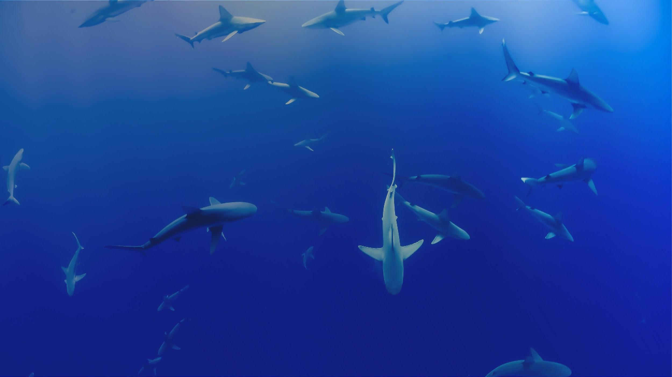

The OTN Data Centre and OTN Data Nodes
Jon Pye – Director of Data Operations
Notes:
Hi, my name’s Jon Pye, and I’m here to lead you all into this week’s Node Manager Training, by describing what Nodes are meant to do, why OTN makes them, and how they help with the vital and difficult task of coordinating a whole telemetry community’s data and producing cross-project detection matches for everyone who contributes, and across all the communities who participate.
It’s my hope that you’ll soon have a sense of not only what a Node is, but also of
OTN’s mandate
the benefits of the Node system as a community outgrows more organic person-to-person sharing,
the relationship between OTN and its Nodes,
as well as a realistic understanding of the work involved in hosting/maintaining a Node.

Slide 2


ABOUT OTN
Global aquatic research, data management and partnership platform headquartered at Dalhousie University in Nova Scotia, Canada.
Since 2008, OTN has been deploying ocean monitoring equipment and marine autonomous vehicles in key aquatic locations globally.
OTN has established partnerships with a global community of stakeholders to document the movements and survival of aquatic animals.
Knowledge generated by OTN is used to help guide management decisions and the sustainable use of aquatic systems.
OCEAN TRACKING NETWORK
Notes:
First, a bit about who I am and what the Ocean Tracking Network does. We’re a global infrastructure network funded by the Canadian Foundation for Innovation and headquartered here at Dalhousie University. We’ve been operating since 2008, deploying ocean monitoring equipment in key locations around the world, and more recently we’ve done a little oceanography and limnography by accident here and there using ROVs and gliders. We establish partnerships with a global community of stakeholders to document the movement of aquatic animals in the changing ocean. The knowledge collected by OTN-affiliated researchers has been useful to policymakers, industry, Indigenous and coastal communities, and the general public.

Slide 3

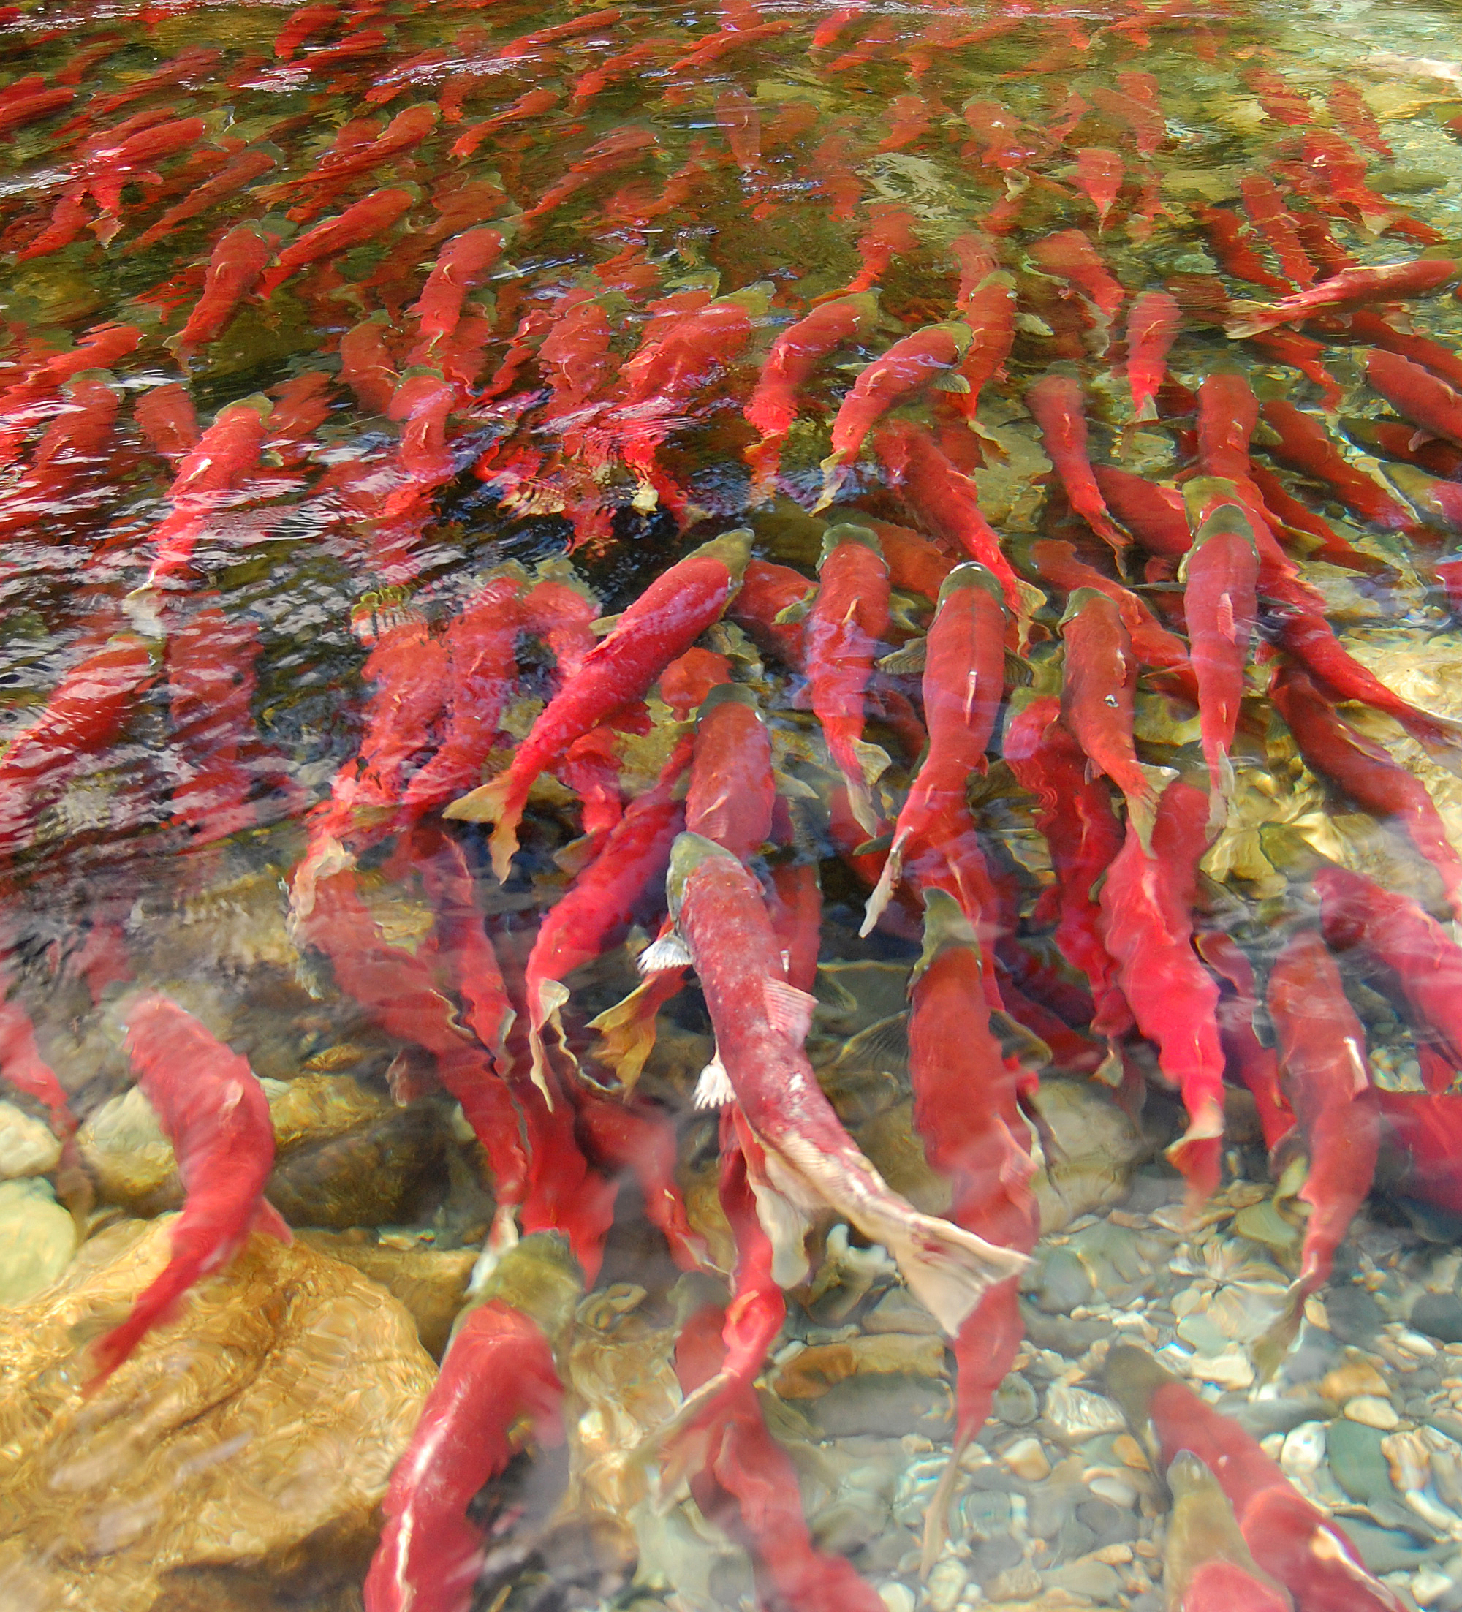
Digital Infrastructure
Thorough and uniform metadata optimizes discovery and secondary applications for project data
Improve inter-project sharing as well as designing standards for publication
Share resources, capabilities, techniques, not just data
OCEAN TRACKING NETWORK
Notes:
How do we as data managers help fulfil that mission, how can we work to be optimally relevant to stakeholders, and to provide value to the researchers who choose to partner with us? There are a couple of needs and concerns researchers have that data managers are well positioned to help with w.
When you are looking to share your data, or when you’re trying to use a colleague’s data to supplement your own, the key is making sure everyone is recording that metadata and data to a uniform standard. We can help different groups arrive at that standard.
The more information collected and recorded about a project or study, the more likely we can help others discover that data once it’s published and find new applications for the results. For the last decade and more, OTN-affiliated researchers have helped us refine and revise our data collection to arrive at something that’s maximally useful while remaining manageable for field work.
This work is ongoing, and we are always listening and looking for ways to make things easier on folks, and making sure we are collecting and recording the data that is needed.
By having a well-understood (by humans and by computers) set of fields for recording metadata about your field work, you will find it easier to collaborate, and in telemetry research, you derive so much benefit from sharing data with your neighbors, and the world
Not just sharing the data, but being able to plan future deployments, rely on other programmes or network-maintained core lines to supplement observing efforts, and also in being able to share and quickly implement techniques for data analysis so long as they’re anticipating the same format of input metadata and data. We partner with folks who are writing analysis packages and help backstop these institutional or volunteer efforts where they are serving the community and filling in important parts of the data pipeline.

Slide 4

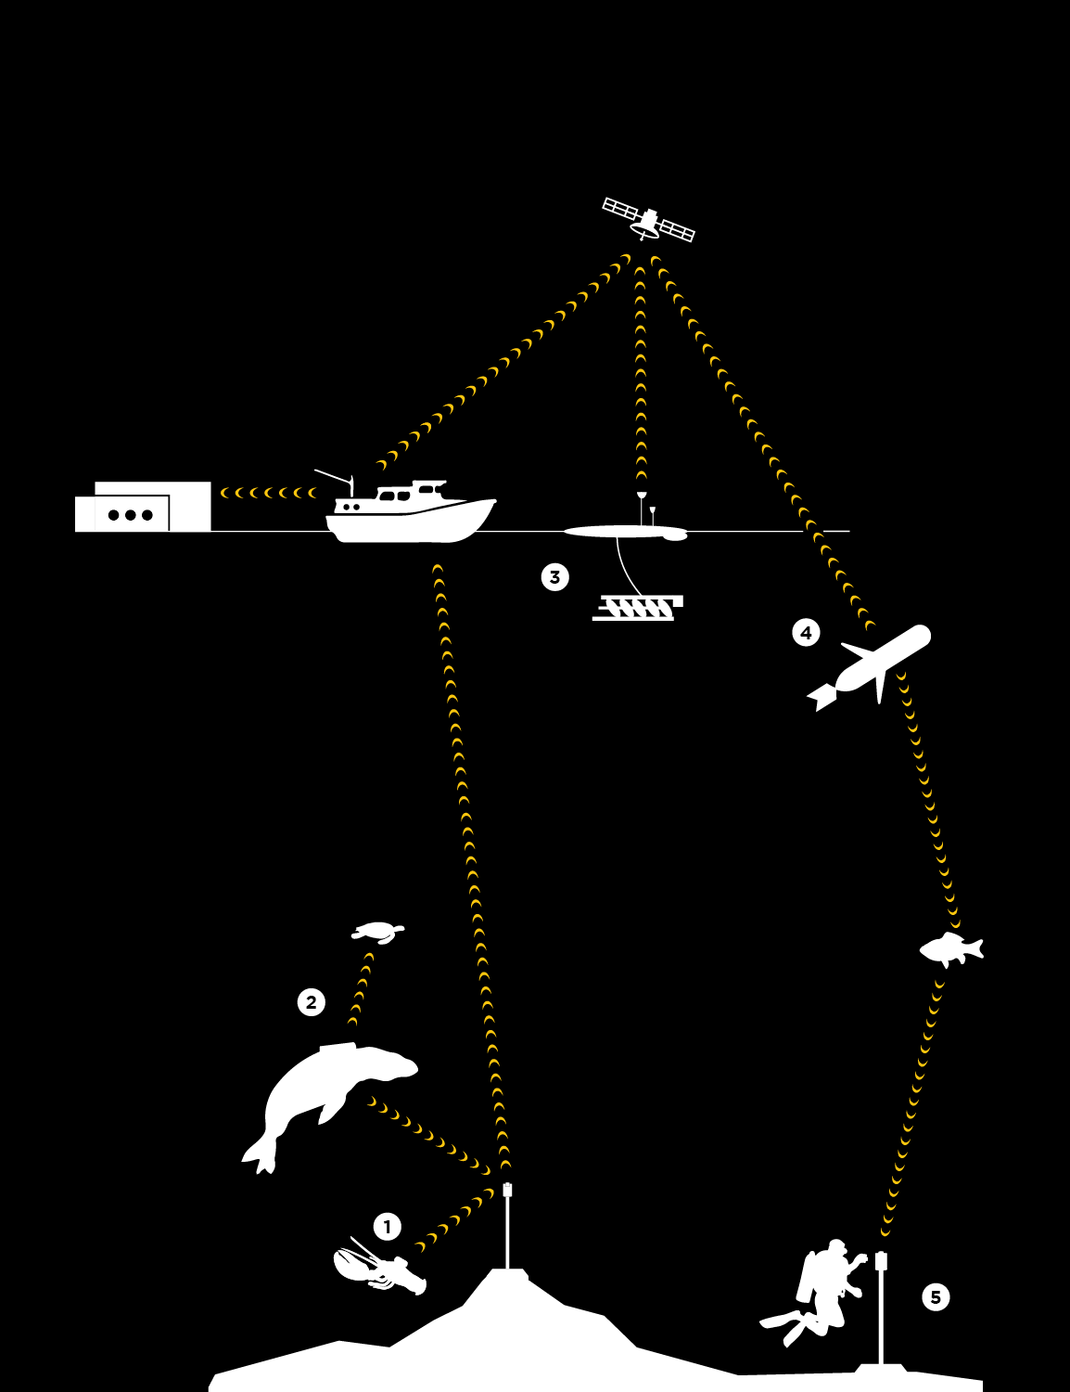
OTNDC / Node Data Workflow
Labs/Institutes report data to data center, as collected via a variety of platforms and technologies
Standardized ingest into the Databases, QCed data matches animals detected across projects/platforms
Data reported to tag owner, w/ links back to all contributing projects
Data format for detection extracts are expected input into telemetry analysis software in R and Python
OCEAN TRACKING NETWORK
Notes:
So under the framework of our CFI funding, we as an organization are meant to provide ‘infrastructure support’. Organization-wide, we get this done in a few different ways. OTN funds and maintains a set of core acoustic telemetry receiver lines around the world that researchers can leverage and rely on when designing their own studies. We loan out receivers we aren’t able to use or maintain in order to supplement others’ studies. We co-design and help innovate new ways to attach listening equipment to new platforms, like our Slocum and Wave Gliders, and more recently to ocean physics drifters and ROVs, and that helps lower the engineering costs and smooth the way for new research projects to adopt those techniques in turn.
But even within the data shop, we’re infrastructure too. ‘Infrastructure’ to us means being on standby to receive, quality-control, and aggregate the data that’s reported to our databases from individual projects, labs, institutes, citizen science programmes using any or all of these technologies, performing the cross-network matching of the QCed detections, and reporting the most complete picture of that data back to the researchers who deployed the tags. These researchers can take their network-wide detection extracts, which are in a nice tabular data format, and use them as the input into community-built open source telemetry analysis software.

Slide 5
Why the Node paradigm?
Tobler’s first law of geography:
“Everything is related to everything else. But near things are more related than distant things.”
Data collation and management within regions is the proper-scaled approach to organic collaboration and coordination of effort
Nodes allow regional organizations to cross-reference data and metadata with OTN and provide more data to their end-users
Report-once, track-everywhere from the PI perspective simplifies reporting of metadata and data and keeps a project’s data authoritatively in one place
OCEAN TRACKING NETWORK
Notes:
Something that I’ve been convinced of as we have undertaken this project over the last few years, is that we are all very susceptible to the first law of geography. Researchers tend to be very interested in what’s happening nearer to their study area, and then, depending on their study animals, perhaps progressively less interested in what’s happening further from it. They also tend to share views on what should happen to their data with their nearer neighbors, are more trusting of their neighbors to safeguard their intellectual property, and are likely to agree on how best to work together to cover more area collaboratively with their listening stations.
And for most study species that are observed using acoustic telemetry, the global scale isn’t going to be the most important scale. So to be optimally relevant and useful to a global community of researchers, we at OTN have to empower more localized communities and collaborations. On the data management front, that means we empower the people who have been tasked by their networks to aggregate and disseminate data, to enable them, enable -you-, to guide their data through the quality control pipeline and aggregate it in exactly the same way that we do it in the OTN shop, lightening the burden that is placed on you as regional data managers and allows the data you receive and aggregate to be represented and trustable all the way up to the global picture.
The reality is that this kind of data aggregation isn’t something you only do once you have already designed a database and coordinated data collection techniques with all your prospective colleagues. It starts most often as a shared network folder among a core group, as a series of emails between researchers, as a promise to scour each other’s data for tag detections that belong to you. These methods are a great sign that people trust and value one another, but they do not scale well at all, three researchers can keep in touch, but twelve? Twenty? Because the value of sharing detection data grows with everyone who agrees to do so, it’s often the case that the will to collaborate scales up much more quickly than the capacity of any one person to facilitate it. This is where we can use Nodes to make an impact, facilitating sharing among larger communities and guaranteeing a standard that can carry a contributor’s data all the way to the global aggregate. And if all of our data sharing agreements are sufficiently aligned, this provides global matching to data providers for a participating Node.
So this is how and why we’ve come to support this strong regional organizing tendency, both at a policy level, and with technology, keeping regional data management regimes empowered and in control of their constituencies' data where it’s possible. To this end, we designed our database so that it’s easy to maintain your own structure, certify and train the communities and operators who have adopted them into participating Nodes, and share and co-develop new additions to the structure and code that we all use to populate, QC and aggregate our data.
We have maintained in-house versions of our database for regions since 2008 and the beginnings of OTN, first with OTN and the NorthEast Pacific and ATAP in South Africa, but we started sharing out the Node software for independent operators in the FACT Network in late 2016. Since then we’ve sought to increase the autonomy and capacity of each regional node, hosting training sessions like this one to keep node managers up to date on the latest tools and techniques. We try and hold these training events once a year, depending on global circumstances.
One final thing worth mentioning, is that investigators are no better at respecting borders than their study animals. From a PI perspective, the intercompatibility of nodes means that we can track their membership in the many networks and respect the policies that go along with their programme’s activities in each locality. This ends up being a much nicer arrangement for the PI than managing membership in multiple networks. They report their data regionally to their closest collaborators, and the software takes care of ensuring that they benefit from the global network, and that a single, authoritative repository of their data is maintained at the place they are most likely to update and curate it regularly.

Slide 6
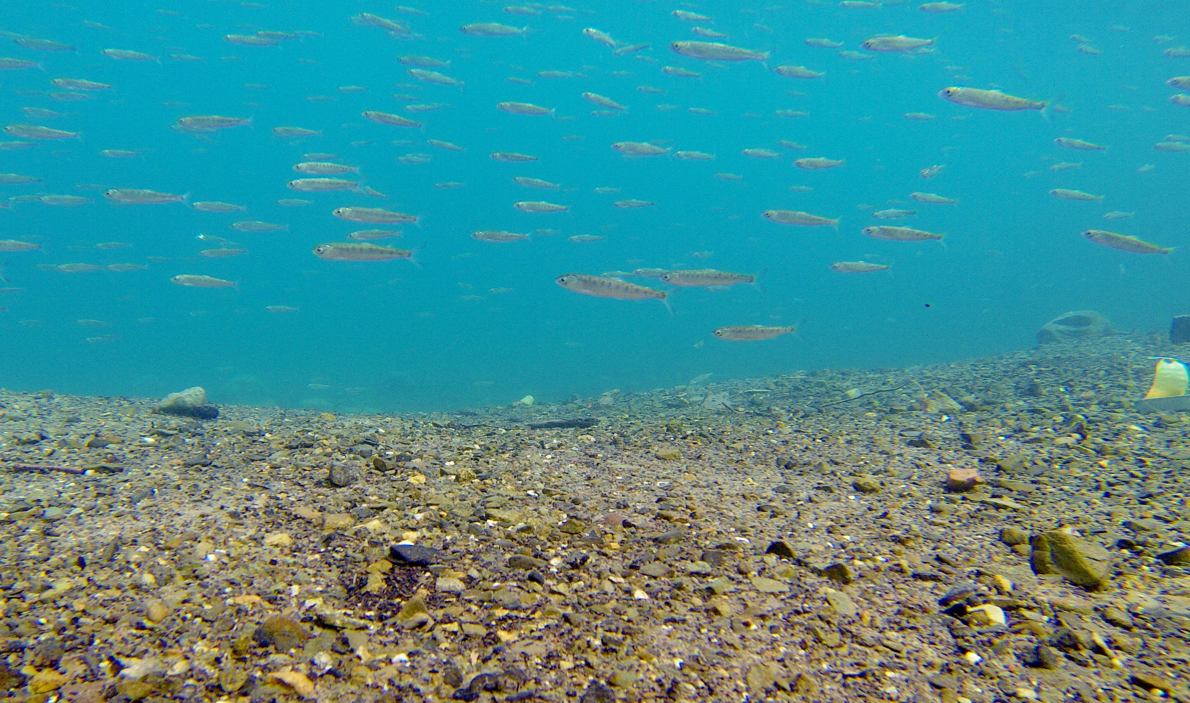
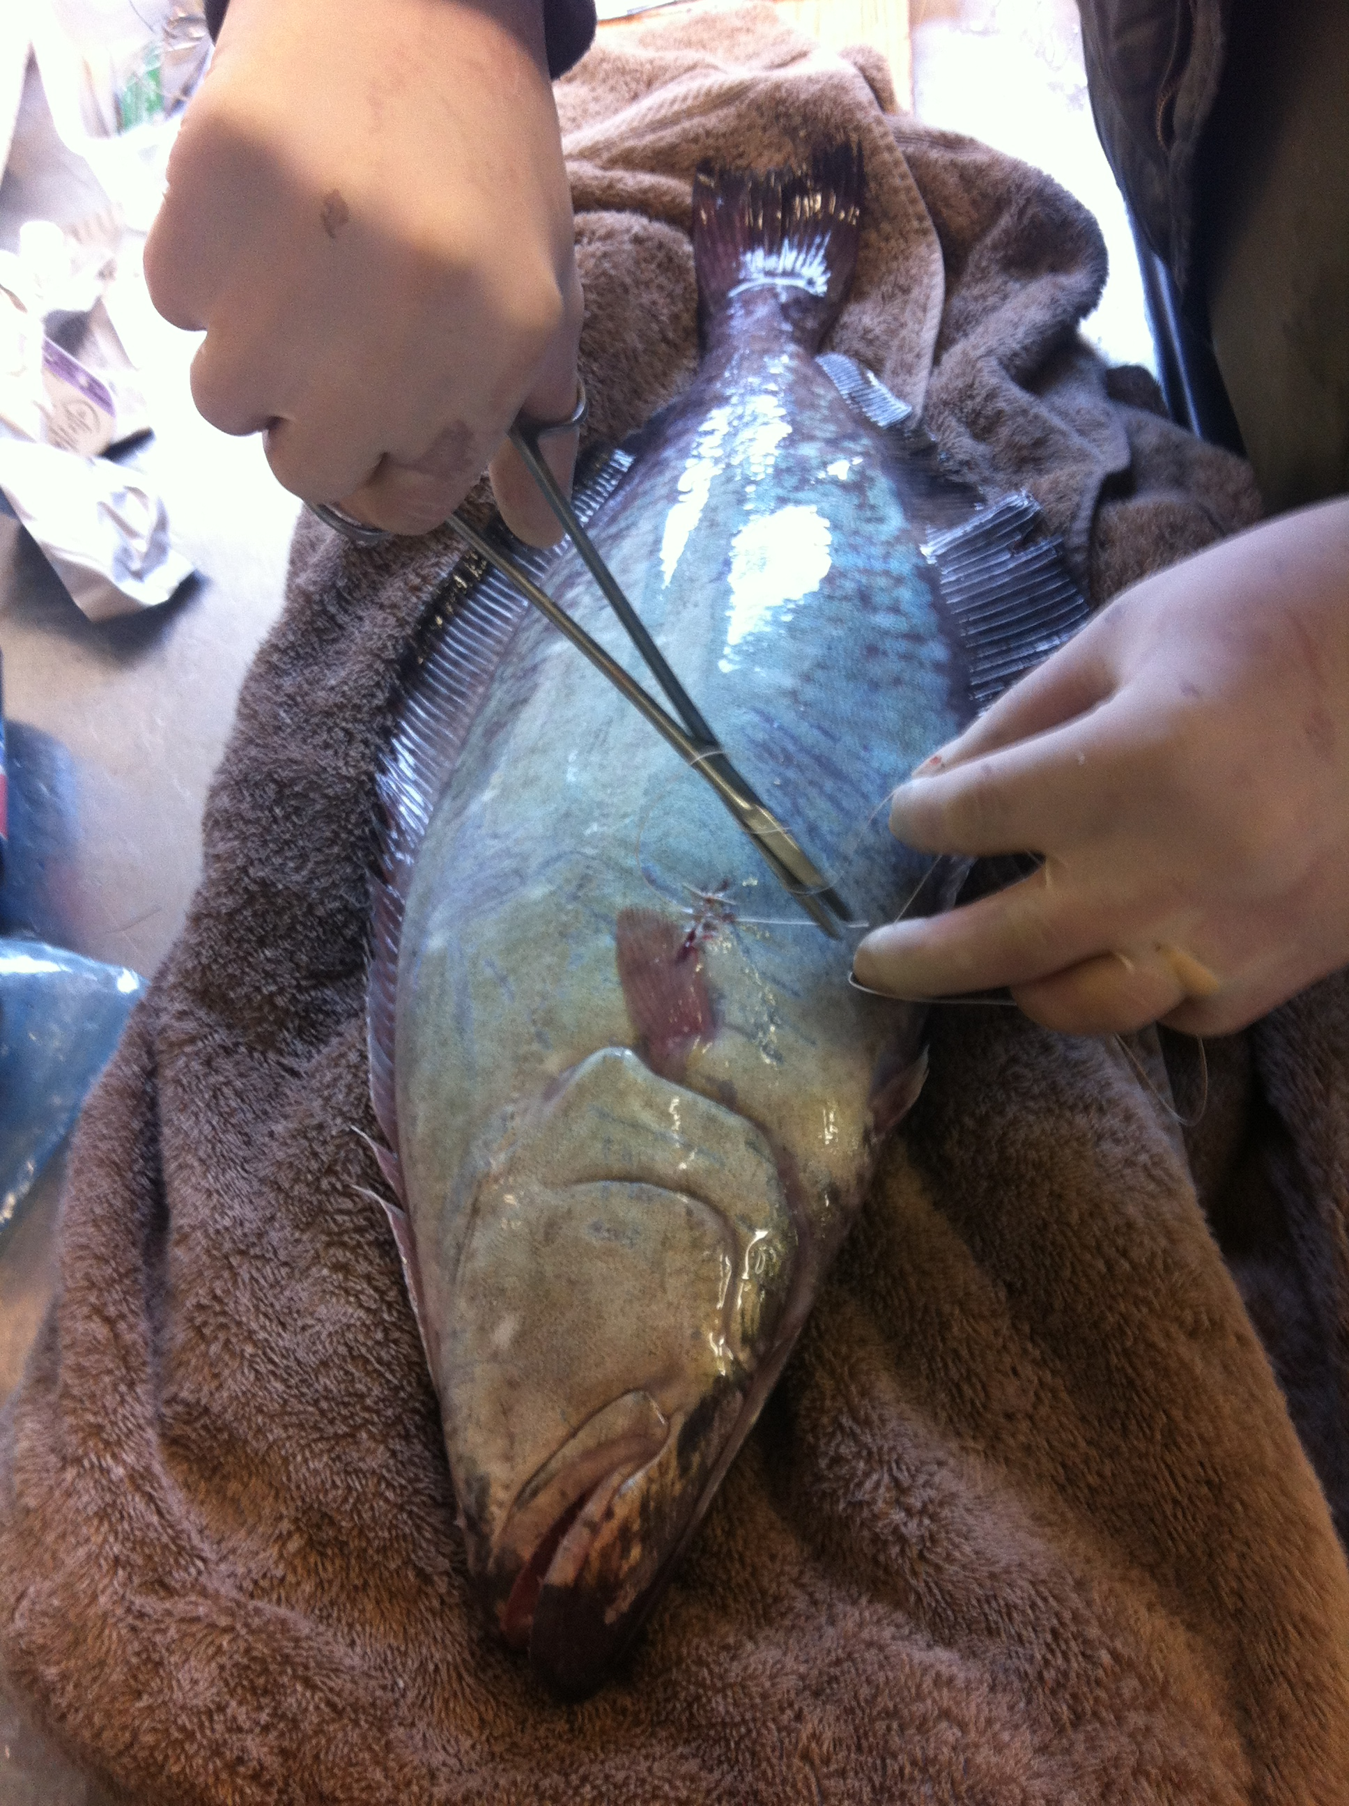
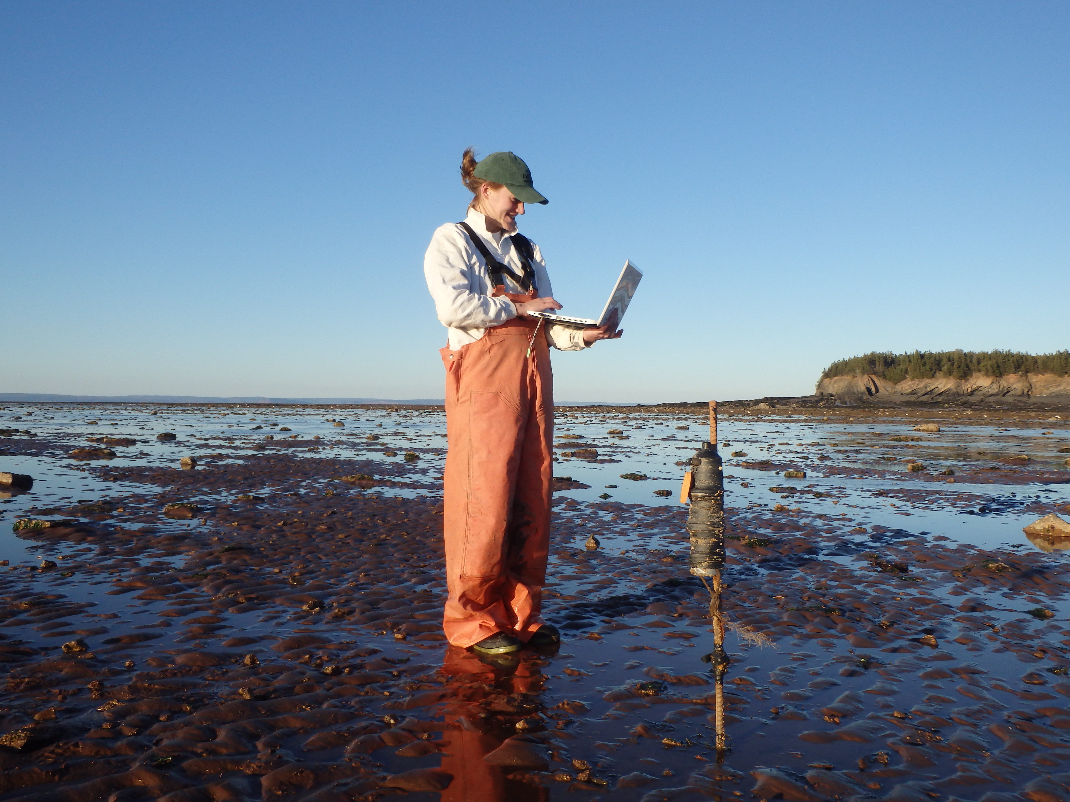
Three main components of acoustic telemetry data
Detection data: protected but not very informative without associated tagging activity data to add the ‘what’ to the ‘where’ and ‘when’.
Detection Event
Detection Data
Receiver Deployment
Tagging Activity
Tagging activity: The history of which tags are in which animals, where those animals were released, how long the tag will live, + measurements and observations made at tagging time. OTN Embargo = tag life + 2 years
Receiver deployments: generally uncontroversial and publishable data. Useful for informing potential collaborators of existing equipment deployed in their intended study areas that could detect their tags.
OCEAN TRACKING NETWORK
Notes:
In order to make clear how OTN’s data policy affects the way Nodes share data, it’s important to outline how we think about each type of data in turn. At the entrance to the data pipeline, there are generally three big kinds of data (plus project-level metadata), that we all need to process in order to produce animal presence information, and we’ll deal with each of them over the course of the week. I look at this graphic and the most interesting thing about it to me is that two out of the three pieces of information that fix any animal detection in space and time come from the humans recording them, often by hand. [CLICK] Receiver deployment history gives us the location for a detected tag. [CLICK] Tagging activity gives us the animal that was carrying the tag with that code at that time, [CLICK] and then the instrument itself records times and tag codes and matches those two bits of information together to give us this animal, at this time, in this place. This is the part of the data that most agree is the sensitive piece, and here is where we can apply an embargo to easily manage the release of potentially sensitive information into the public sphere. OTN’s embargo begins to tick down at the moment the tag batteries are estimated to have expired, and by default last 2 years. Researchers can waive that embargo at any time to speed up the publication of their data, or apply for an extension to slow it down. Nodes are not bound to follow the details of this specific embargo, and can design and implement their own rules for publication that will follow the tag information registered in their Node as it collects detections from projects within their Node or from other participating Nodes.

Slide 7
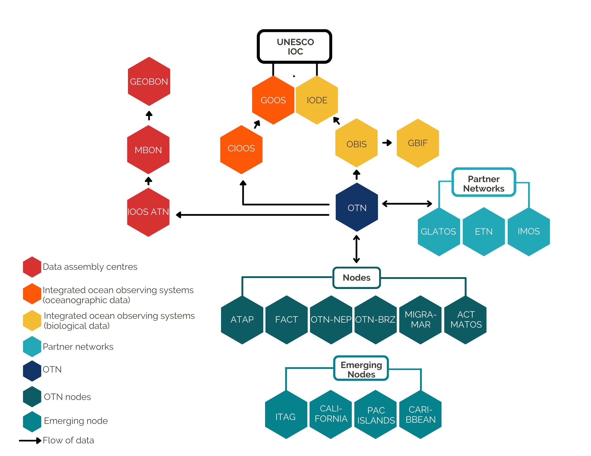
What’s in a Node?
Shared tools, common processes
Direct inter-compatibility w/ other OTN-style nodes
Detection resolution between nodes
Same QA/QC process and data output formats
Develop new processes alongside OTNDC + comm.
Periodic training sessions and ongoing support for node managers
OCEAN TRACKING NETWORK
Notes:
So at a high level, that’s the game. By sharing a common set of processes, we can all run to QC incoming data, and by having the exact same format in the OTN database as in each of these nodes, we can achieve inter-compatibility. The common QA/QC processes give us confidence in making comparisons and matches across these distinct data systems, and the output formats are standard between nodes, meaning they’ll be compatible with the analysis packages that are designed to accept them. That helps us share analysis tools as well among all these disparate communities of researchers.
The other major benefit about OTN having so many collaborators globally using the same system, is that regions will discover new use cases and configurations, new problems and technologies that we will all have to become fluent in. In building capacity and connectivity between you coordinators and database managers, we also get insight into emerging needs of all of our communities and are provided an opportunity to collaboratively tackle these challenges. This makes the extra overhead of open development and rigorous change management worthwhile, to be in the know sooner about new ideas, and to get our system caught up to speed with the help of data folks from around the world.
As a link in the chain between researchers collecting animal presence and movement data and the global understanding of marine biodiversity, OTN and our partner Nodes have the ability to work together across regions and disciplines to securely and accurately move information towards decision makers and help our researchers create change from local to global scales.

Slide 8
Training Schedule
https://ocean-tracking-network.github.io/node-manager-training/
Monday
Tuesday
Wednesday
Thursday
Friday
Node Concept
Node Struct. + Outputs
Setup and Install
Data Loading Workflow
Project Metadata
Tagging Metadata
Deployment Metadata
Detection Loading
Supplementary Notebooks
Data Push
Study Hall?
Fixing Data Errors
Upholding the Data Policy
Notebook Improvement and Development
Tandem Real Data Loading w/ OTNDC
OCEAN TRACKING NETWORK
Notes:
A schedule for the full week we have planned looks a little bit like this. The lessons we have prepared are very hands-on, each of you will work as data managers in the same Node and have a folder full of data that you will process and load from our Fictional Narwhal Tracking Project. Because of this, some of the lessons may take longer, some may take less time, but generally we will have four of these four-hour sessions to work through the prepared lessons on how to use the software to deal with each data type and generate detection data products from the database for your contributors. There’s even possibly some potential for us to meet a few of the students and early-career researchers who attend OTN Study Hall on Thursday if we are well enough ahead of time. We will also come back to help out on Friday if you are interested in getting started with your own Node. We will walk the folks who have a Node already set up through loading real data into their Node.
So right after this we will hand it over to Angela Dini, OTN’s Database Manager to walk us through the structure of the OTN data system and its outputs, then we’ll ensure that you have your installations all taken care of before going into what the data loading workflow looks like in more detail, and hopefully we’ll have time today for the first part of starting a new project in the data system, the loading of the project-level metadata.

